Slide 1
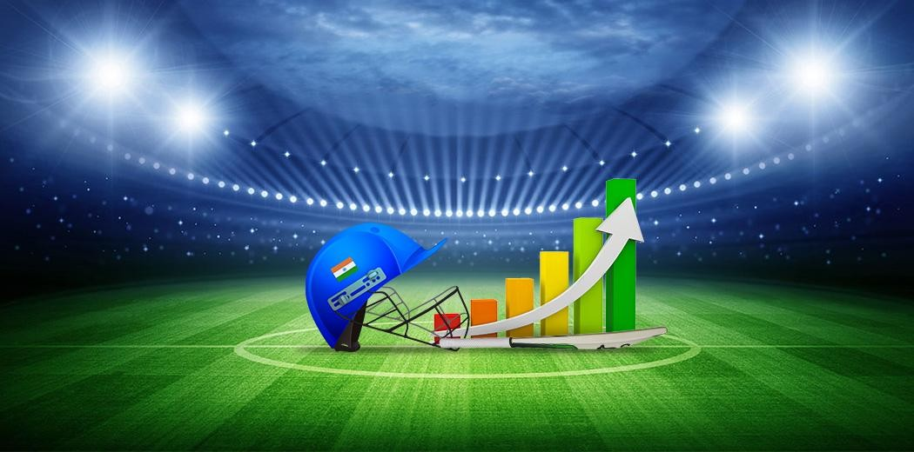
PERFORMANCE ANALYSIS OF PLAYERS AND FANSTASY 11
GROUP 3 :
Adarsh Rao Akula Hyma Roshini gompa Sai Varun Kotha
Shri Aiswarya Gorle Sujeeth Reddy Sithagari

Slide 2
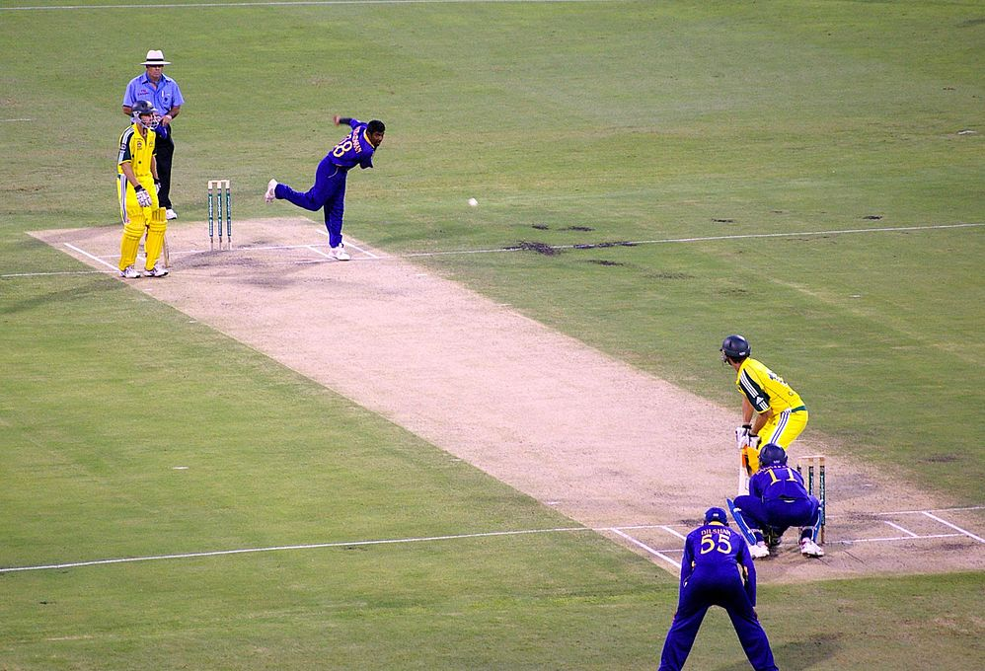
INTRODUCTION
This project involves analyzing a cricketer’s performance
To get insights on individual statistics, match results, and team dynamics.
Identifying Key Players
Strategic Planning

Slide 3
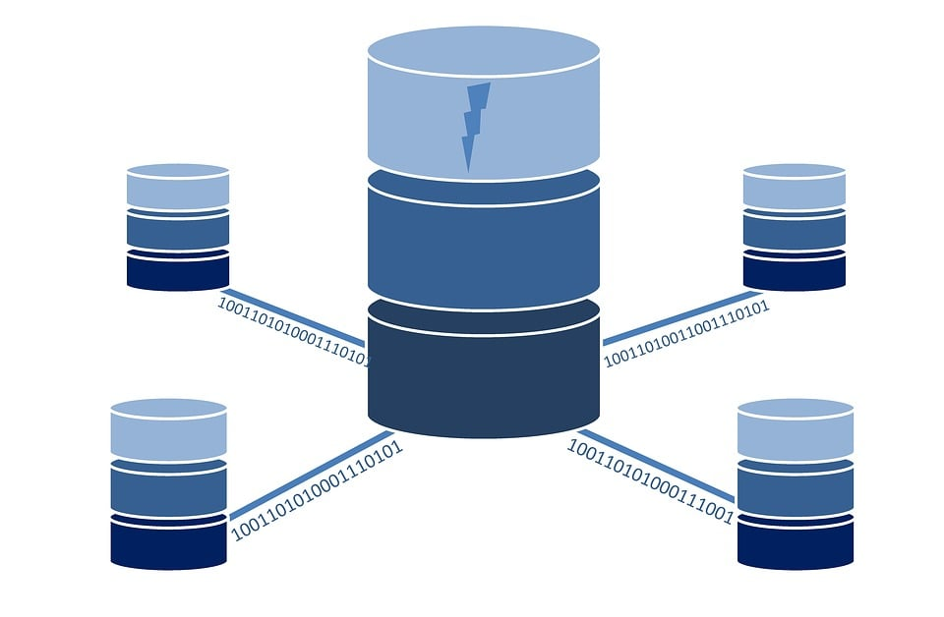
UNDERSTANDING THE DATASET
Datasource is to be taken from Kaggle
The dataset consists the T20 stats of players all around the world since 2007
There are three datasets for batting , bowling and fielding respectively
Collection of diverse data types including individual player statistics (batting average, strike rate, wickets taken), team performance records, and match outcomes.

Slide 4
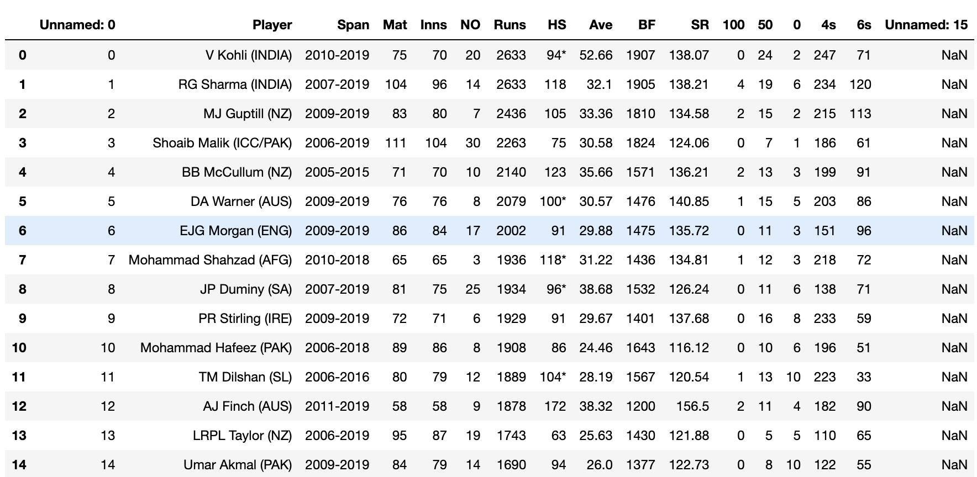

Slide 5
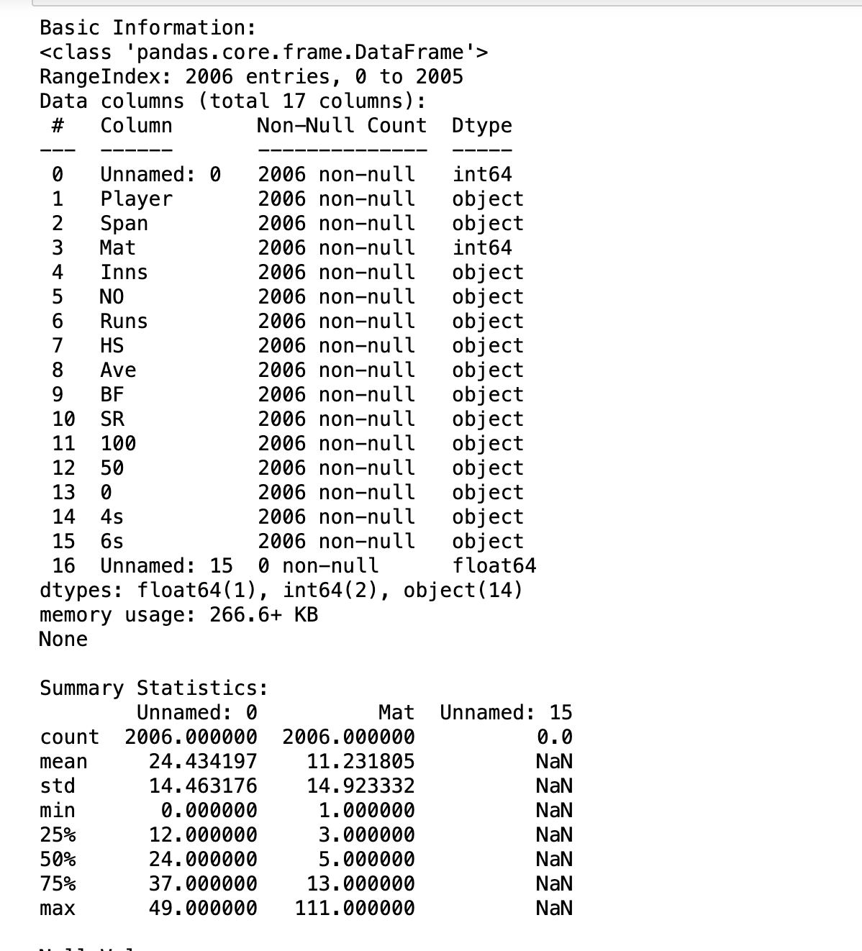
EDA Analysis
We have replaced the null values with the mean of the total values
We have replaced the column names accordingly
Removed the unwanted columns.

Slide 6
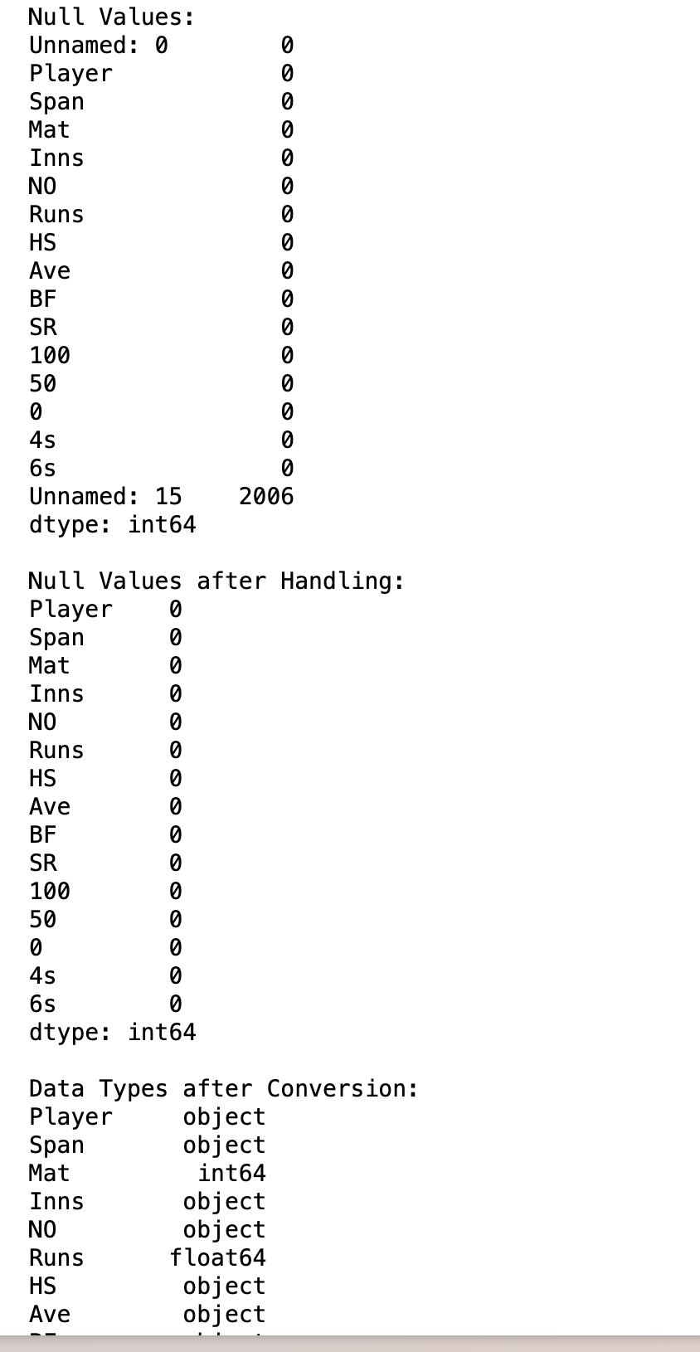
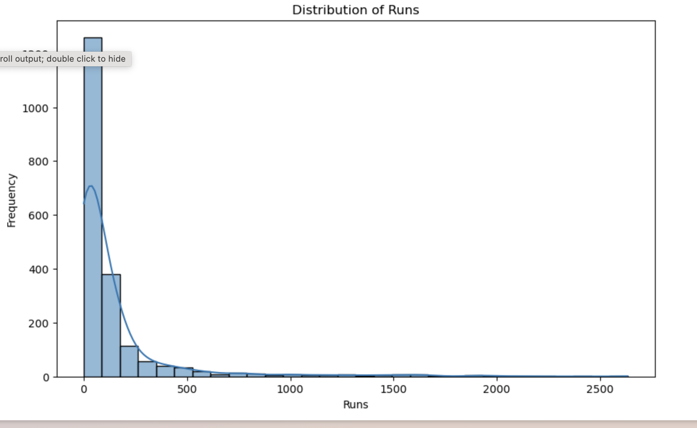

Slide 7
PROPOSED ALGORITHMS
SUPERVISED LEARNING
Decision Trees: This can be used to classify players into different categories based on their performance metrics, such as high, medium, or low scorers.
Logistic Regression: If you have a binary outcome, such as predicting whether a player will score a century in the next match (yes or no), logistic regression can be used.
UNSUPERVISED LEARNING:
K-Means Clustering: This can be used to group players into clusters based on similarities in their performance metrics, helping to identify patterns and categories among players.

Slide 8
FEATURE ENGINEERING METHODS
Implemented Weighted Average method: To calculate a weighted average of the runs scored by each player, with the weights based on the number of matches played.
it's an overall measure of batting performance in the dataset, taking into account both the runs scored and the number of matches played by each player.

Slide 9
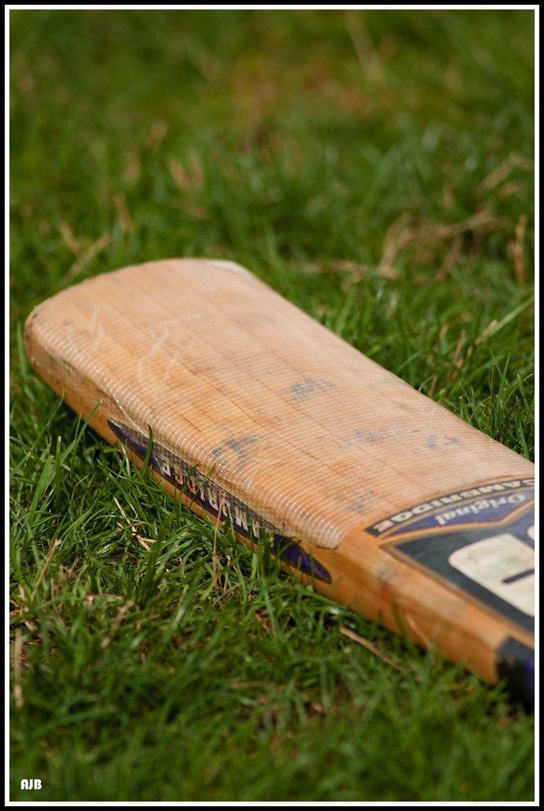
BATTING ANALYSIS USING LINEAR REGRESSION
Data Preparation:
Removed unnecessary columns and cleaned data, converting 'Runs', 'Balls Faced', and 'Strike Rate' to numeric values and handling missing values by filling them with column means.
Feature Selection:
Selected 'Runs', 'Balls Faced', and 'Strike Rate' as the features for predicting the batting averages of the players.
Model Training:
Data was split into an 80-20 ratio for training and testing. A Linear Regression model was trained on the training dataset.
Performance Prediction:
Predicted batting averages and then ranked batsmen not only by these predictions but also by their actual strike rates to highlight both scoring efficiency and potential impact..

Slide 10
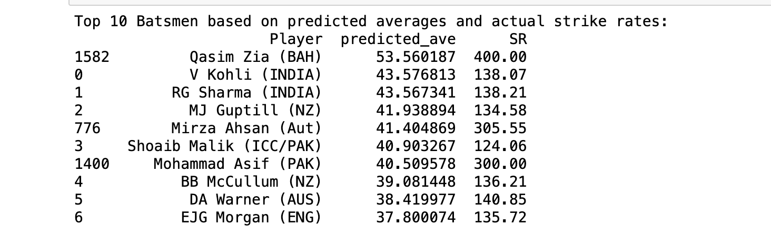
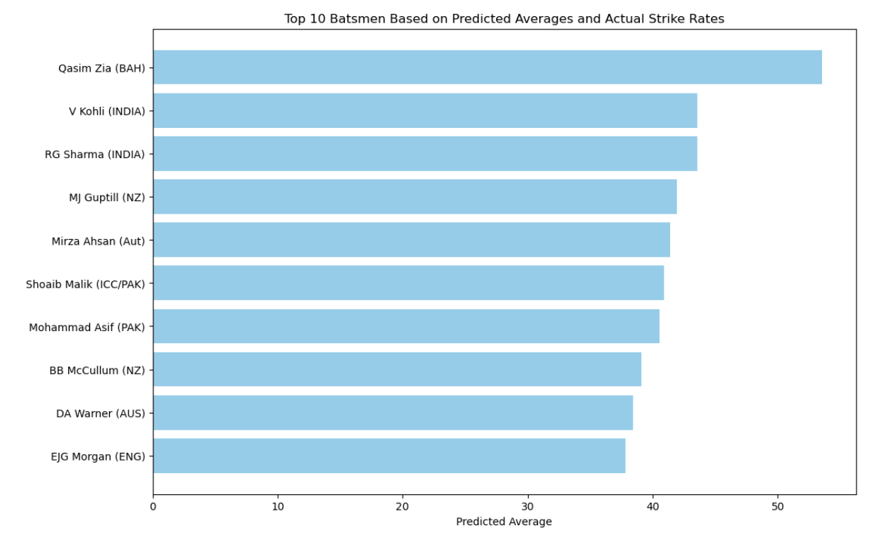
OUTPUT & VISUALISATION

Slide 11
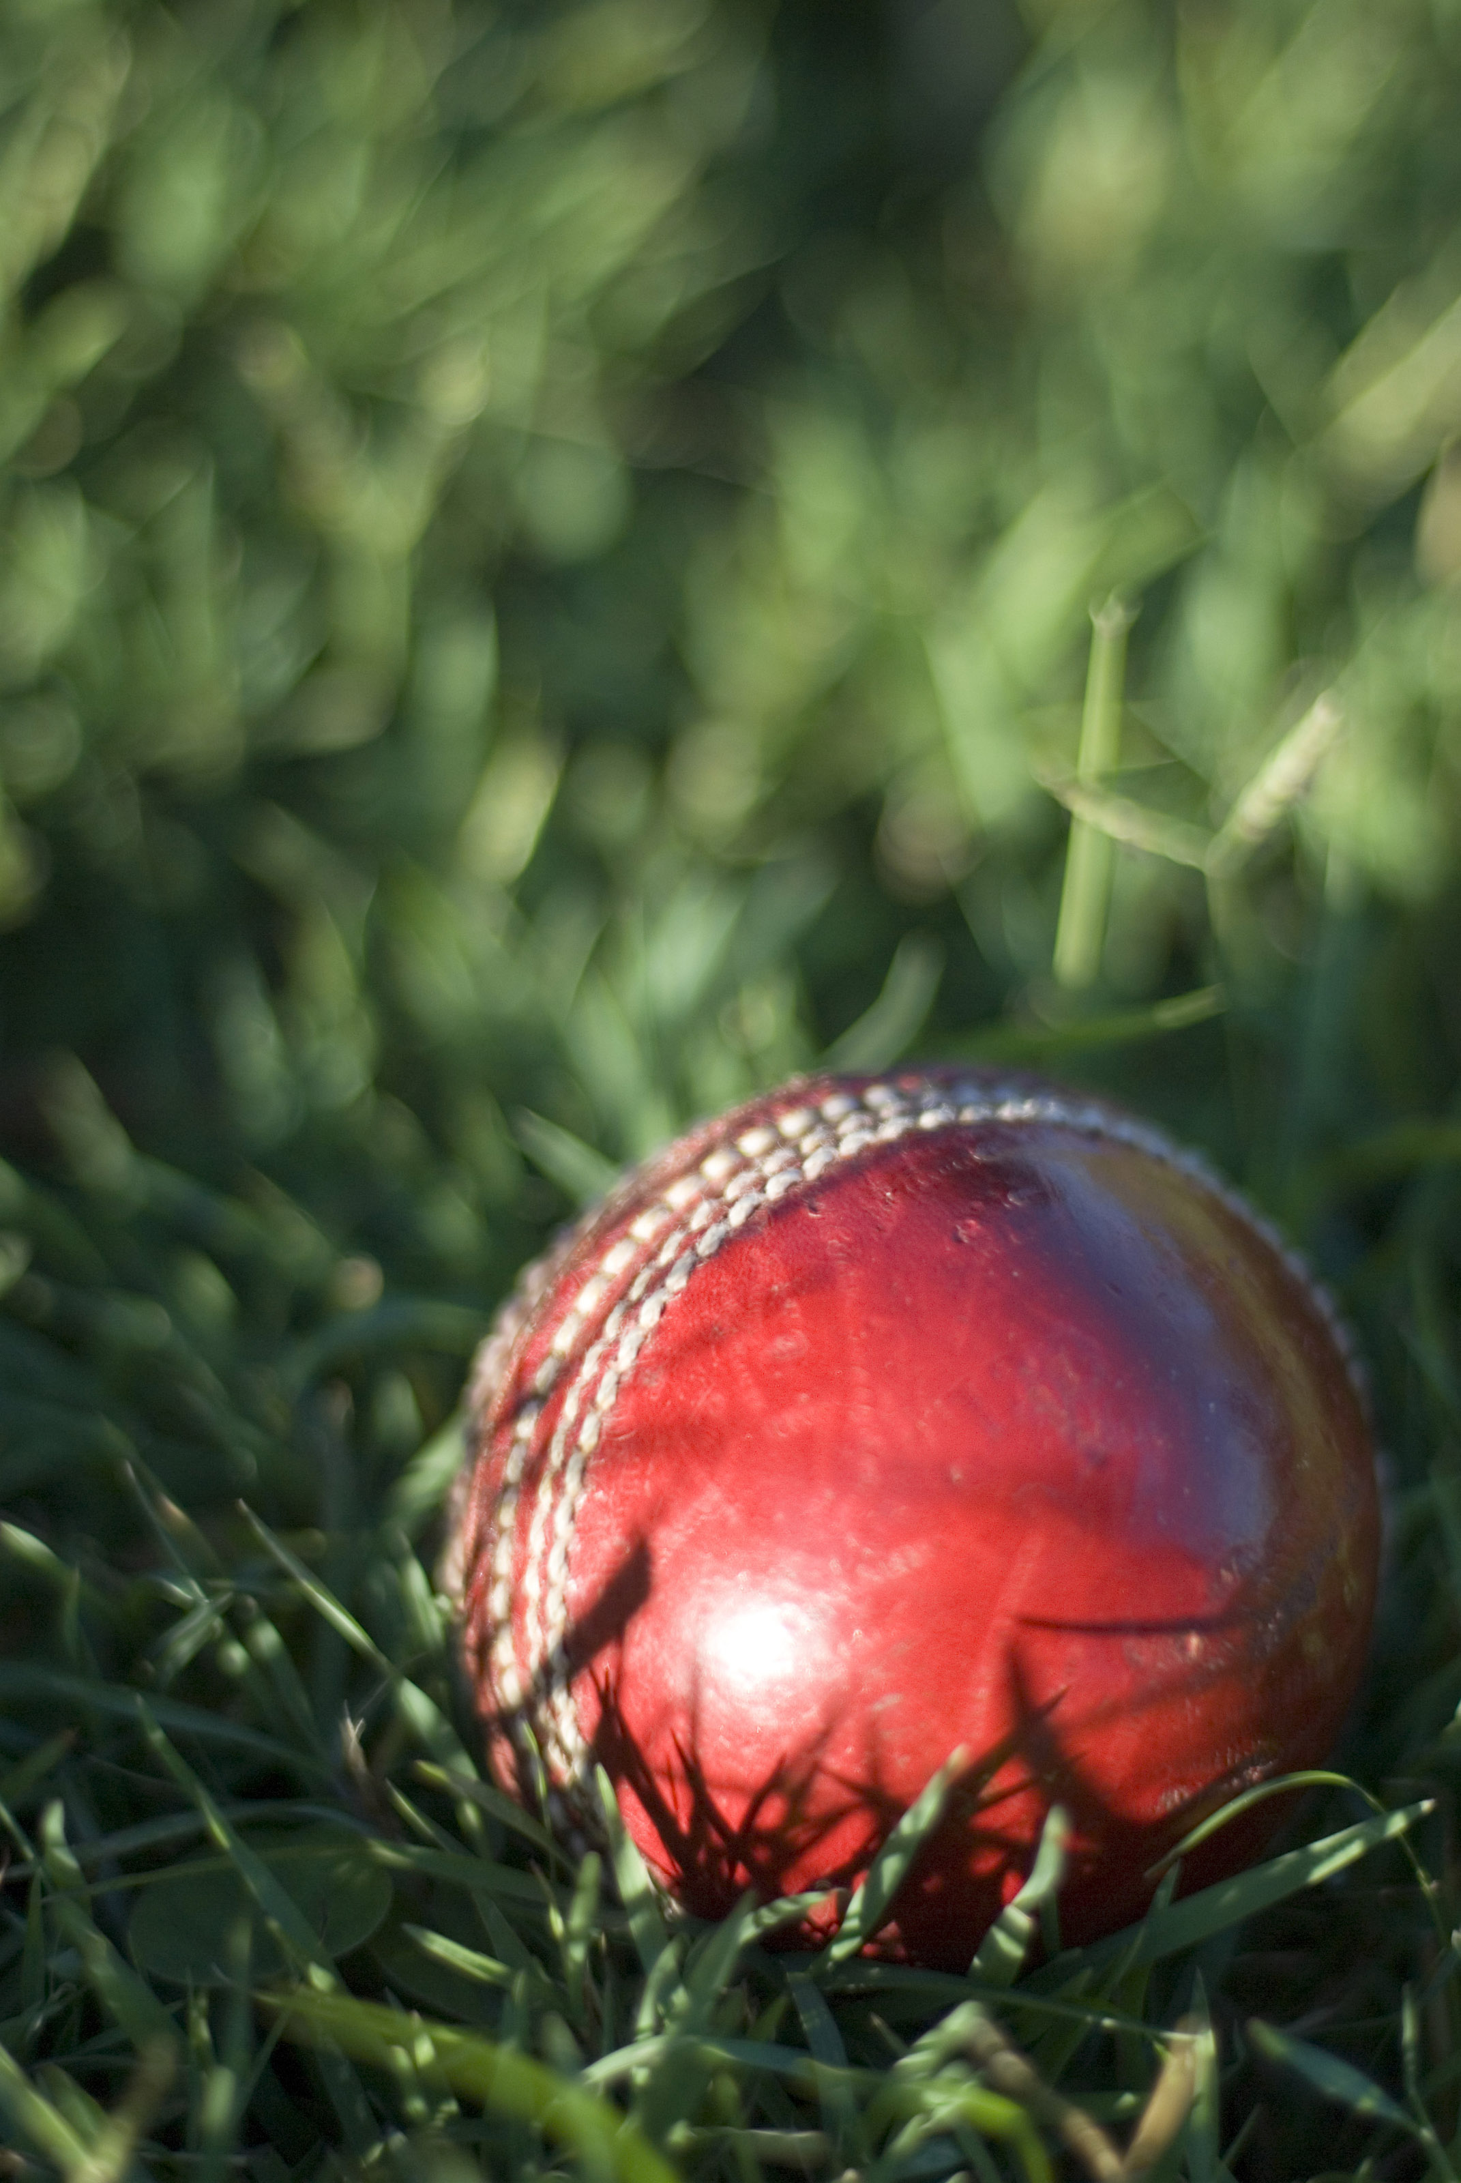
BOWLING ANALYSIS USING DECISION TREE REGRESSION
Data Preparation:
Removed unnecessary columns and cleaned data, converting 'Wickets' and 'Average' to numeric values and handling missing values by filling them with column means.
Feature Selection:
Selected 'Wickets' as the feature for predicting the average runs conceded per wicket by the bowlers.
Model Training:
Data was split into an 80-20 ratio for training and testing. A Decision Tree Regression model was trained on the training dataset.
Performance Prediction:
Predicted the average runs conceded per wicket using the model, and then ranked bowlers by the number of wickets taken and the predicted averages to identify the top performers who are efficient in taking wickets and conceding fewer runs.

Slide 12
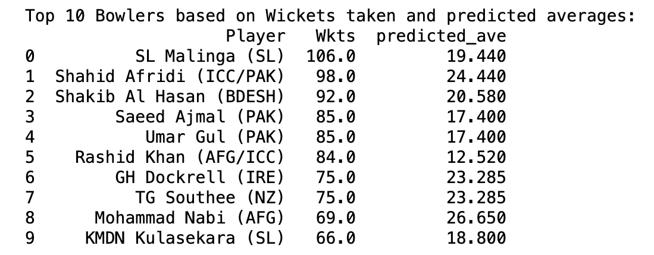
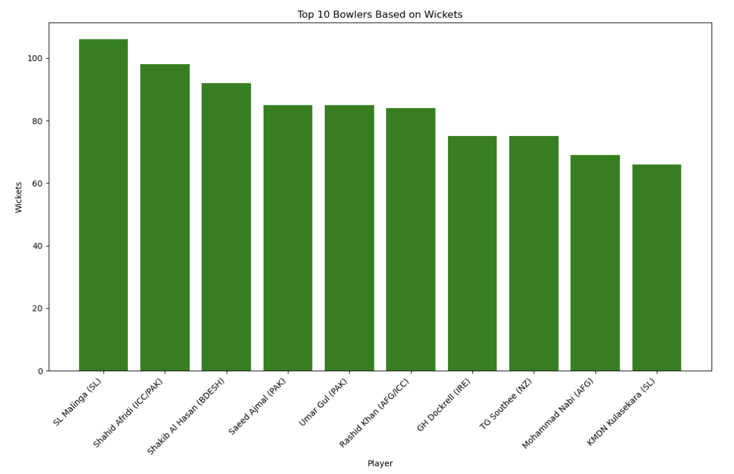
OUTPUT & VISUALISATION

Slide 13
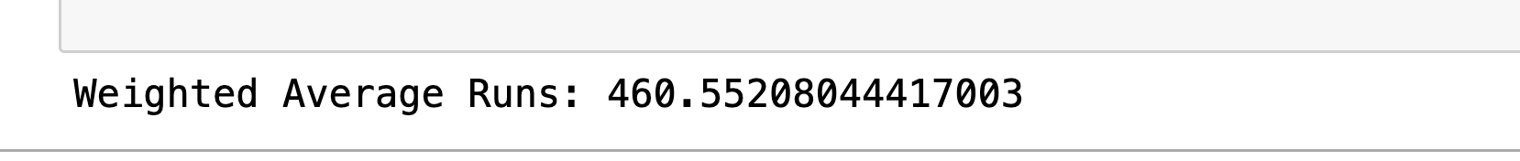
Calculation of Weighted Average Runs in T20 Cricket
The code computes the weighted average of runs in T20 cricket, emphasizing the number of matches played. It multiplies each player's runs by their games, sums these products, and divides by the total matches played. This method highlights players who perform consistently over more games, providing a deeper insight into scoring efficiency relative to their participation. The result is then displayed.

Slide 14
Calculation of Weighted Average Bowling in T20 Cricket
The code calculates the weighted average of bowling averages in T20 cricket, factoring in the number of matches each bowler has played. It multiplies each bowler's average by their respective matches, sums these weighted averages, and then divides by the total number of matches. This approach prioritizes bowlers who have maintained good averages across many games, offering a more nuanced view of bowling efficiency. The computed weighted average is then displayed, giving a clearer picture of bowler performance adjusted for experience.

Slide 15
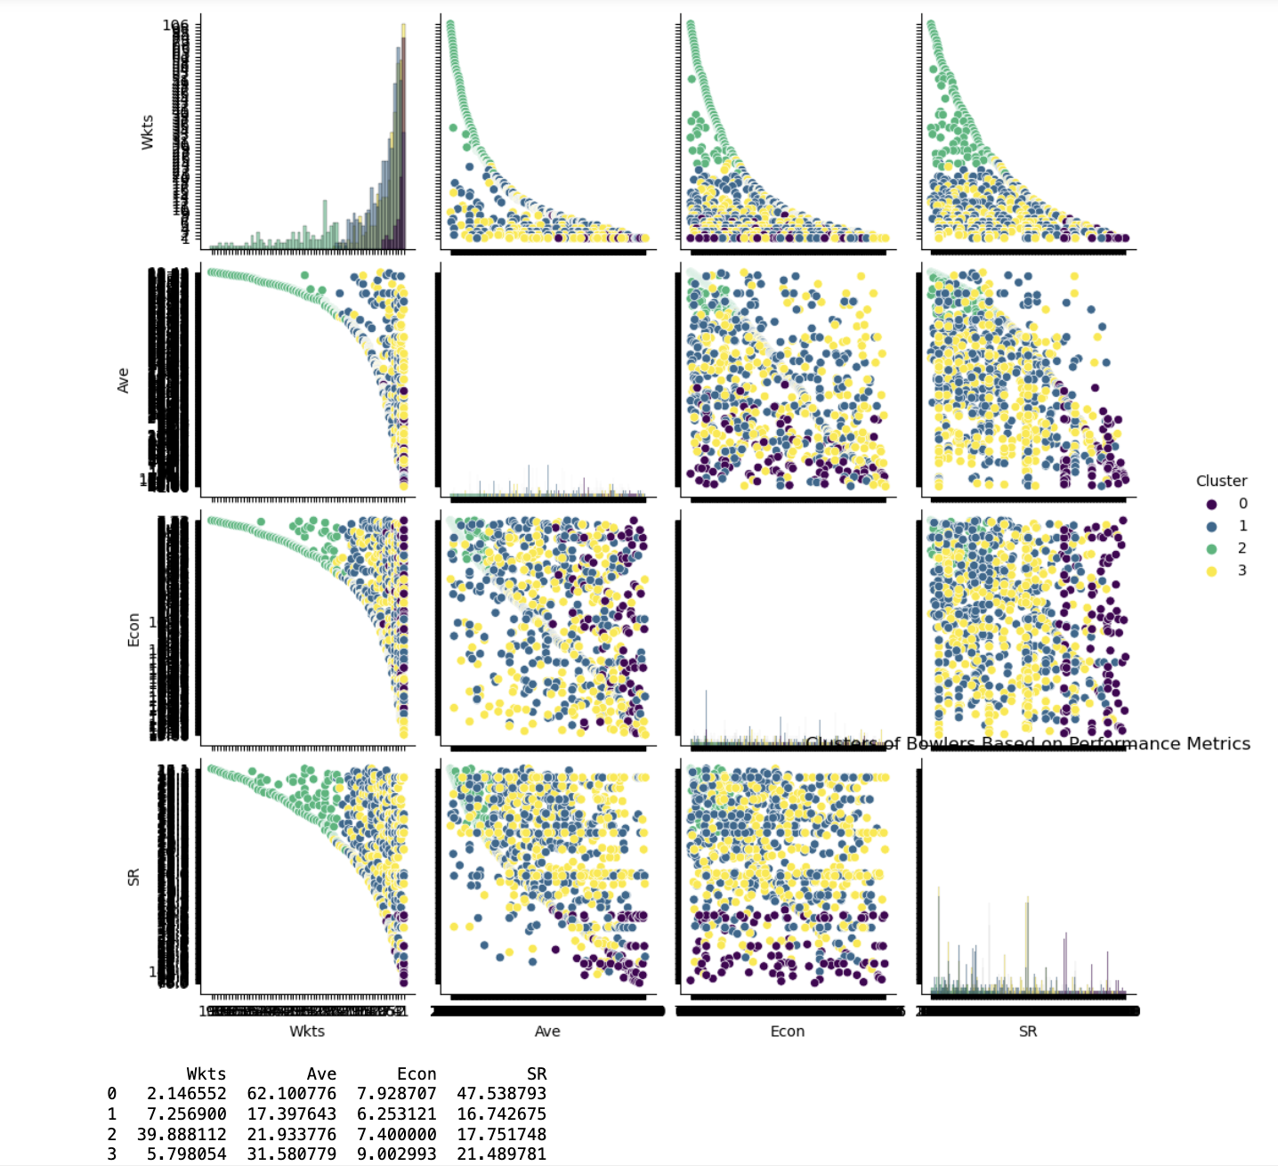
CRICKET BOWLING PERFORMANCE CLUSTERING
Data Preparation:
Converted bowling statistics to numeric values and cleaned the dataset by removing rows with missing data to ensure accurate and reliable inputs for clustering.
Feature Normalization:
Standardized the bowling statistics to give each feature equal importance in the clustering analysis, ensuring that each metric contributes appropriately without bias due to scale differences.
Model Training:
Implemented K-means clustering with four clusters to categorize bowlers based on their performance metrics. This helps in identifying patterns and grouping similar types of bowlers together.
Analysis and Visualization:
Visualized clusters using pair plots to examine how bowlers are grouped based on their performance metrics. Analyzed the centroids of each cluster to understand the defining characteristics of each group, providing insights into what makes each cluster unique in terms of bowling performance.

Slide 16
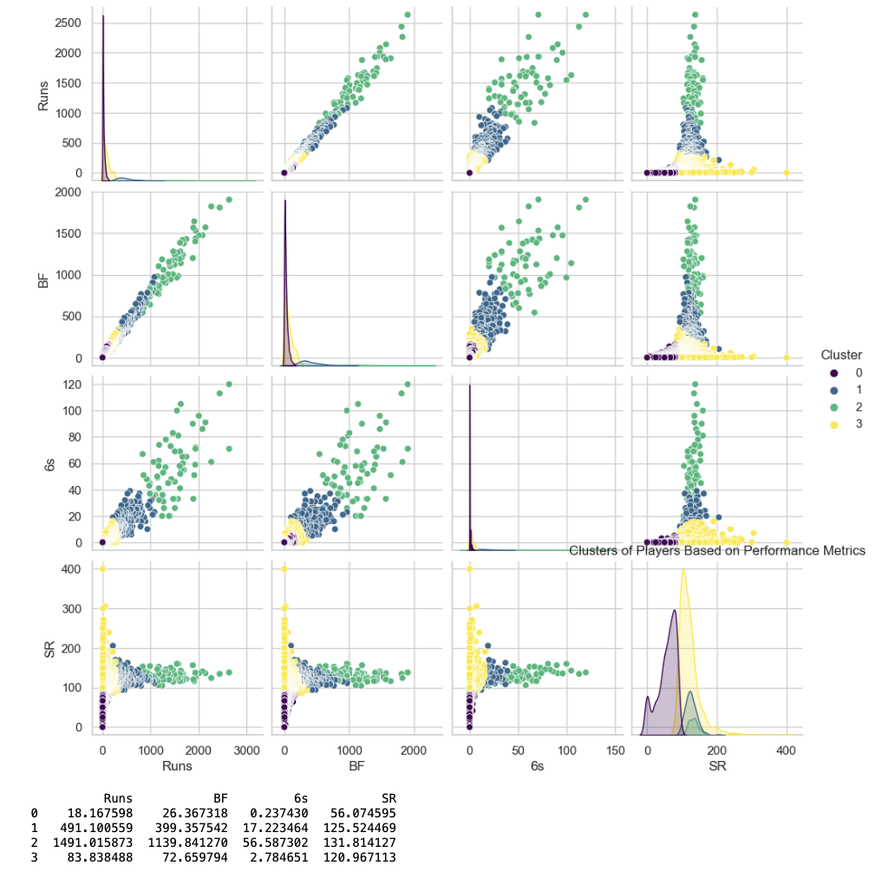
CRICKET BATTING PERFORMANCE CLUSTERING
Data Preparation:
Converted performance metrics to numeric values and cleaned the dataset by removing rows with missing data.
Feature Normalization:
Standardized the performance metrics to give each feature equal importance in the clustering analysis.
Model Training:
Implemented K-means clustering with four clusters to categorize players based on their performance data.
Analysis and Visualization:
Visualized clusters to examine how players are grouped and interpreted the characteristics of each cluster by analyzing centroids.

Slide 17
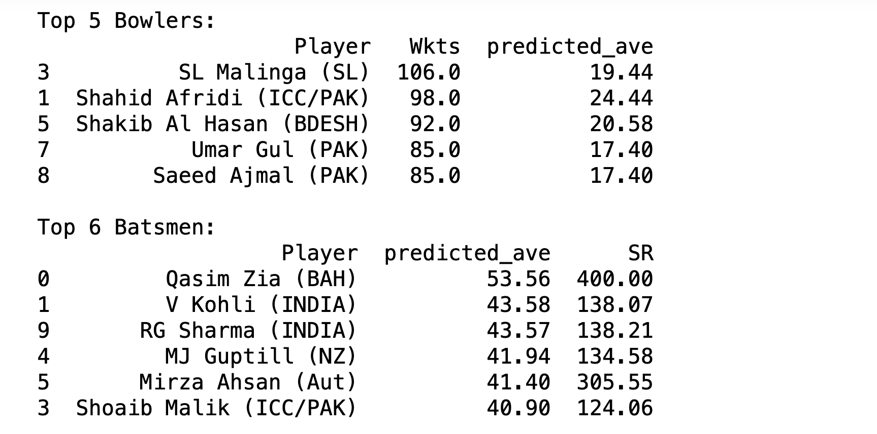
FANTASY 11
Data Preparation
Initialized and converted data for top T20 bowlers and batsmen into Pandas DataFrames for easy manipulation.
Data Shuffling
Randomly shuffled the dataframes to eliminate ordering bias, using a fixed seed for reproducibility.
Selection and Display
Selected top performers based on key metrics and displayed the results, identifying leading players in each category.

Slide 18


